Slide 1
MACHINE LEARNING PROJECT
HOUSE PRICE PREDICTION

Slide 2
Machine learning
Machine learning enables a machine to automatically learn from data, improve performances from experiences ,and predict things without being explicitly programmed
Working of machine learning
A machine learning system learns from historical data, builds the prediction models , and whenever it receives new data, predicts the output for it.

Slide 3
House price prediction
Predicting house prices can help to determine the selling price of a house of a particular region and can help people to find the right time to buy a home.
Aim of the project
to predict the efficient house pricing for real estate customers with respect to their budgets and priorities.
Motivation for house price prediction
The relationship between house prices and the economy is an important motivating factor for predicting house prices. A property's value is important in real estate transactions. Housing price trends are not only the concern of buyers and sellers, but it also indicates the current economic situation.

Slide 4
Problem statement
determine the housing prices of California properties for new sellers and also for buyers to estimate the profitability of the deal
Let us consider of house with following features :
. Population of the area
housing median age
Households
Median house value
Numbers of rooms

Slide 5
Data sources variables
source of data – Kaggle
Tool used – Jupyter notebook
Variables
= median house value
neighbourhood = recent sales

Slide 6


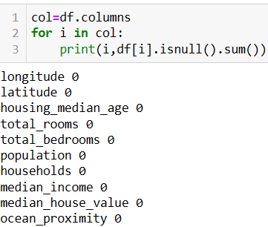
Import libraries
Install the required libraries
Importing data and checking out , As data in csv file , we will read the csv using pandas read_csv
shape of data
Finding the null values

Slide 7
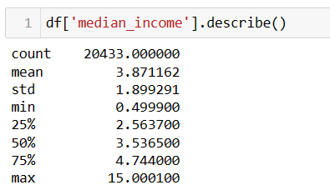

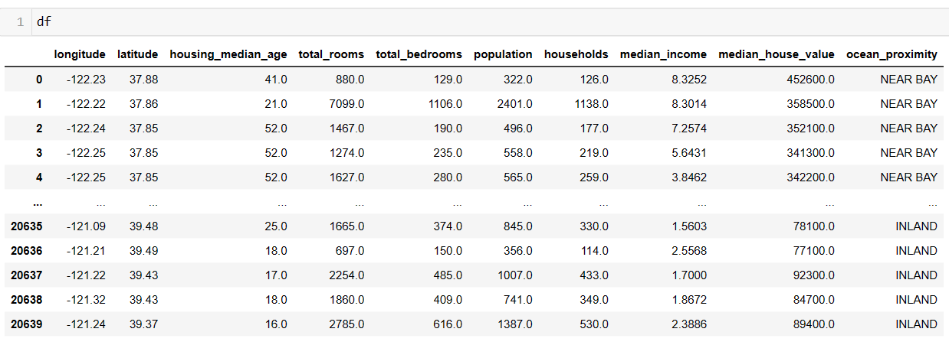
Data cleaning
treating numerical columns with median values
dropping column

Slide 8
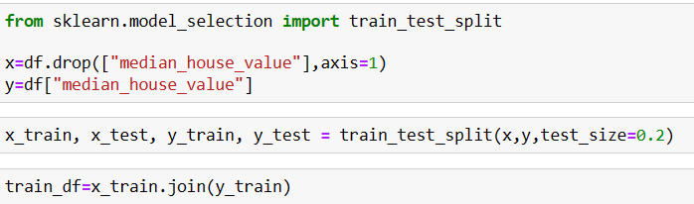
The dataset was split into train-validate- test samples using sampling
After cleaning the data consist of 16346 instances and 14 attributes
Feature standardization was performed on all numeric data variables

Slide 9
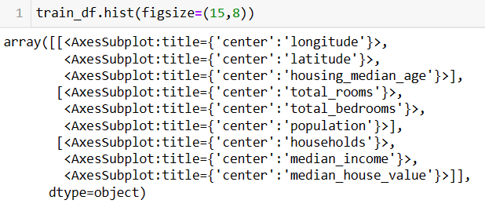
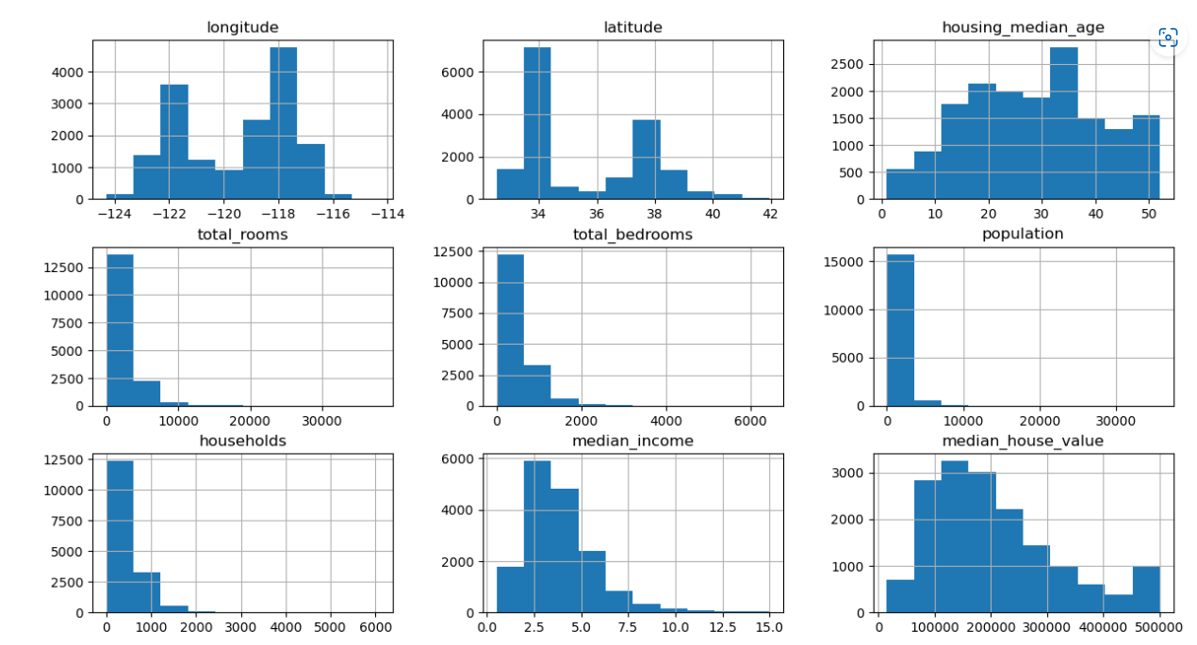
Data visualization

Slide 10
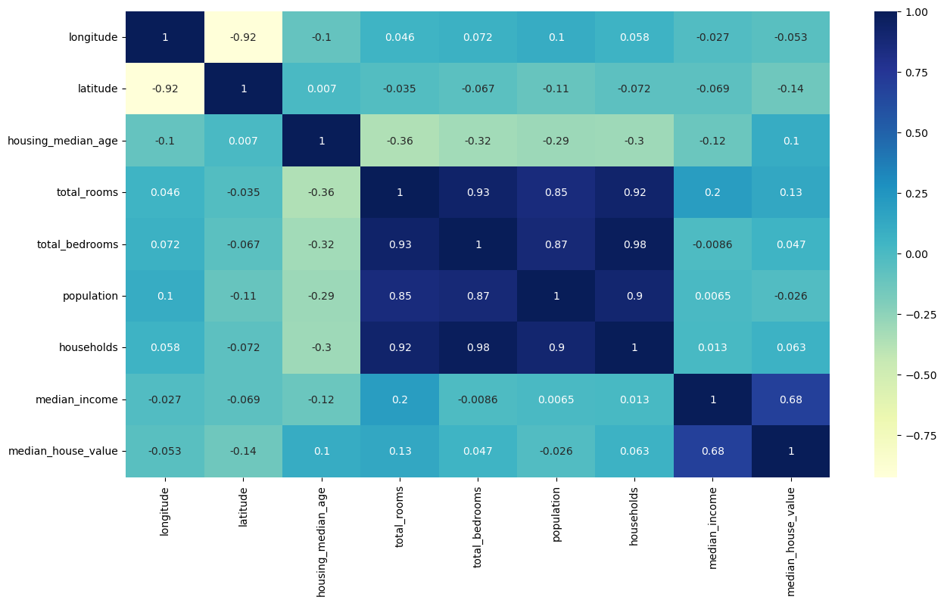

Data analysis EDA heat map-used to find correlation between variables

Slide 11
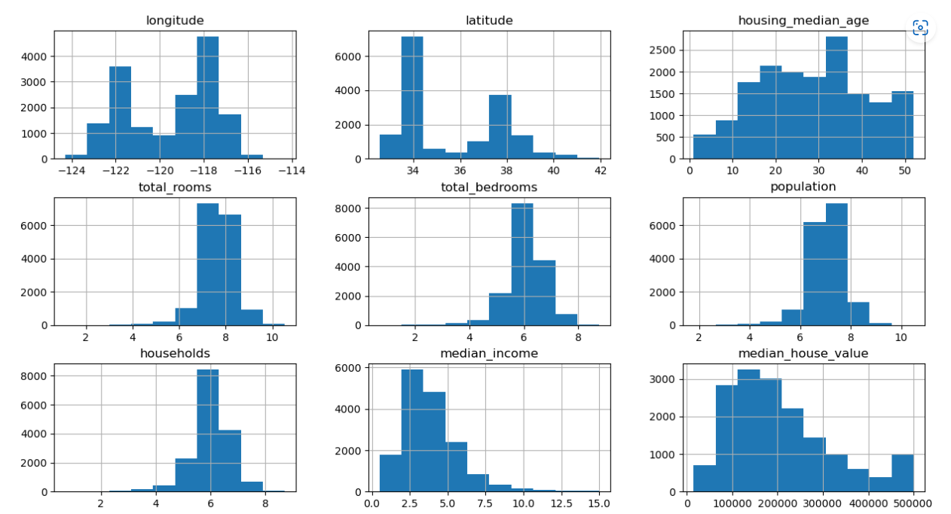


Slide 12
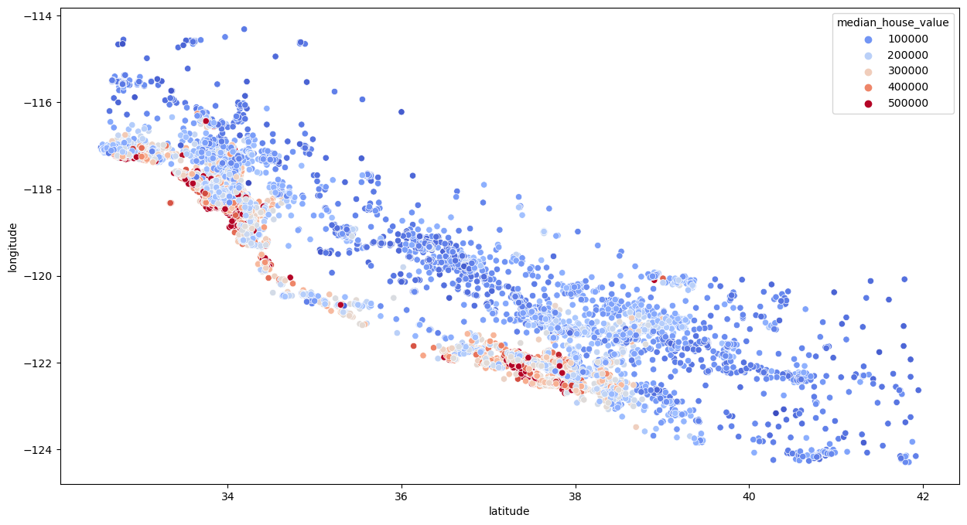
scatterplot

Slide 13
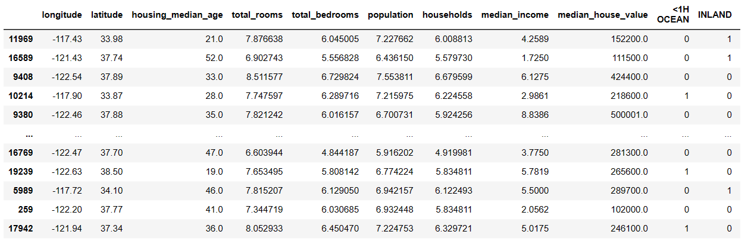
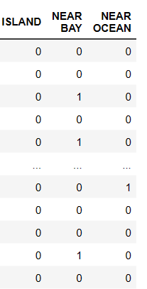
Data exploration converted the text attribute (ocean _ proximity) into categorical data

Slide 14
Linear regression
Linear regression analysis is used to predict the value of a variable based on the value of another variable.
The variable you want to predict is called the dependent variable
The variable you are using to predict the other variables value is called independent variable

Slide 15
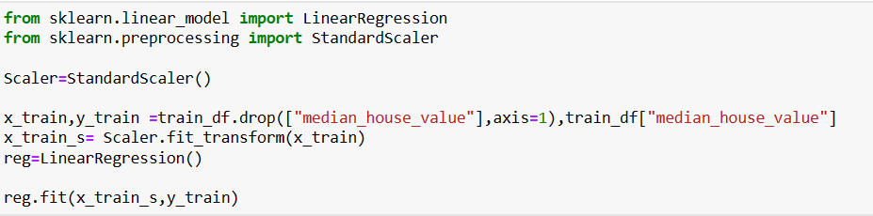
Linear regression

Slide 16
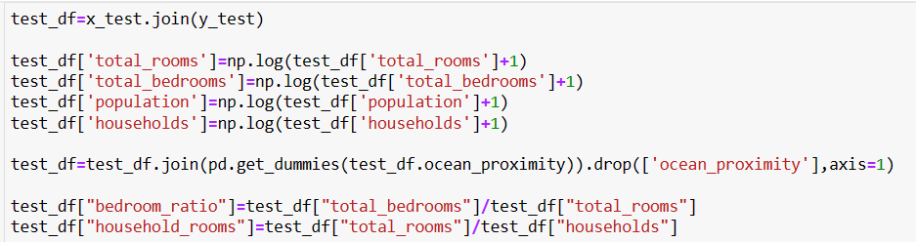


Slide 17
Random forest regressor
Random forest regressor is a supervised learning algorithm and bagging technique that uses an ensemble learning method for regression in machine learning

Slide 18
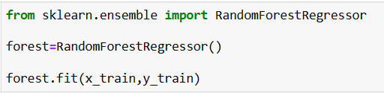


Random forest Regressor

